Slide 1
SANJEEV AGRAWAL GLOBAL EDUCATIONAL UNIVERSITY, BHOPAL
Intelligent Data
Visualization &
Management Dashboard
for Disaster
Submitted by: Shreyansh Pandey (22BTE3CSE11171) • Shubham Vyas (22BTE3CSE10174) • Ankit Kumar Yadav (22BTE3CSE11026)
Guided by:
Ms. Kiran Pachlasiya, Asst. Prof., SSOET | B.Tech CSE – VIII Semester | Spring 2025-26

Slide 2
AGENDA
Intelligent Data
Visualization & Management
Dashboard for Disaster
Presentation
Outline
01. Project Overview
02. Problem Statement
03. Literature Survey
Domain
Platform
04. Proposed System
Disaster Management & Data Analytics
Web-Based (Next.js + TypeScript)
05. System Architecture
06. Tech Stack
Semester
Session
07. Key Modules
B.Tech CSE — VIII Semester
2025-26
08. Data Flow & ER Model
09. UI Design
10. Results & Analysis
Repo
11. Conclusion
github.com/Shreyansh831/dashboard-m-o-n-k-y
12. Future Scope

Slide 3
Project Overview
3 / 15
What We Built
An intelligent, web-based dashboard that collects, processes, and visualizes disaster-related data from multiple sources. It converts complex datasets into actionable visual insights — charts, graphs, maps — enabling real-time monitoring and faster decision-making.
4+
5
Real-Time
AI-Ready
Disaster Types
Monitored
Core
Modules
Data
Updates
Future
Expansion
Key Technologies:
Next.js
TypeScript
React
Node.js
Chart.js / D3.js
MySQL / MongoDB
Tailwind CSS
REST APIs

Slide 4
Problem Statement
4 / 15
Why This System Was Needed
⏱ No Real-Time Updates
📊 Poor Visualization
✍ Manual Data Handling
Traditional systems use static/delayed data, causing slow response during emergencies.
Data shown as raw tables — hard to interpret under pressure, leading to decision delays.
Error-prone manual entry and analysis makes large-scale disaster data unreliable.
🔗 No Data Integration
🔒 Security Gaps
📡 Limited Analytics
Siloed systems across agencies — no unified view of the disaster situation.
Sensitive disaster data lacked proper authentication and encryption mechanisms.
No filtering, trend analysis, or predictive capabilities in legacy systems.

Slide 5
Literature Survey
5 / 15
❌ Existing Systems
✅ Proposed System
• Manual, time-consuming data collection
• Automated multi-source data ingestion
• No real-time data processing or live updates
• Live data updates with real-time dashboard refresh
• Tabular / text reports — difficult to interpret
• Interactive charts, graphs, and heat maps
• Isolated platforms, no central integration
• Single unified platform for all data
• High human error in analysis
• Automated processing minimizes errors
• No predictive or advanced analytics
• Data filtering, trends, and AI-ready architecture
• Non-intuitive interfaces for non-tech users
• Clean, responsive UI for all user types

Slide 6
System Architecture
6 / 15
Four-Layer Architecture
DATA SOURCES
IoT Sensors • Govt. APIs • Field Reports • Satellite Feeds
BACKEND PROCESSING
Node.js Server • Data Cleaning • Real-Time Processing • REST APIs
DATABASE LAYER
MySQL / MongoDB • Disaster_Info • User_Details • Location_Data • Reports
FRONTEND DASHBOARD
React / Next.js • TypeScript • Chart.js / D3.js • Tailwind CSS • Responsive UI
⬆ Data flows upward: Sources → Backend → DB → Dashboard → User

Slide 7
Technology Stack
7 / 15
Built With Modern Web Technologies
Frontend
Visualization
Backend & DB
Next.js 14
Chart.js
Node.js
React framework with SSR & routing
Bar, line, pie, doughnut charts
JavaScript runtime for server
TypeScript
D3.js
REST APIs
Type-safe JavaScript for reliability
Custom data-driven visualizations
Data communication layer
Tailwind CSS
React Hooks
MySQL / MongoDB
Utility-first responsive styling
State and effect management
Relational + NoSQL storage
shadcn/ui
Recharts
Data Validators
Component library for rapid UI
Composable chart components
Input cleaning and sanitization

Slide 8
Key Modules & Their Functions
8 / 15
Modular Architecture — Each module performs a distinct, focused function
Data Collection Module
01
Fetches data from IoT sensors, APIs, government databases, and manual user inputs. Ensures continuous real-time inflow.
Data Processing Module
02
Cleans, filters, and normalizes raw/unstructured data. Converts it into structured format ready for storage and analysis.
Data Storage Module
03
Centralized storage in MySQL/MongoDB. Ensures data availability, consistency, and fast retrieval on demand.
Data Visualization Module
04
Transforms processed data into bar charts, line graphs, pie charts, heat maps. Helps users spot patterns instantly.
Alert Management Module
05
Monitors critical thresholds. Triggers real-time notifications (color-coded: red=high risk) to users during emergencies.

Slide 9
Database Design & ER Model
9 / 15
Entity-Relationship Model
Main Database Tables
USER
Disaster_Info
Type, location, date, severity, status
user_id (PK)
username
email
User_Details
creates ▶
REPORT
role
Authentication, roles, access control
password_hash
report_id (PK)
disaster_id (FK)
Reports
user_id (FK)
DISASTER
Filed incident reports, timestamps, links
content
◀ belongs to
timestamp
disaster_id (PK)
type
Location_Data
location
Coordinates, regions, affected zones
date
severity
Alert_Log
Triggered alerts history, thresholds

Slide 10
Data Flow Diagrams
10 / 15
Level 0 — Context Diagram
Level 1 — Detailed DFD
Disaster
Dashboard
System
1.0
Data Ingest
2.0
Processing
3.0
Storage
User
Data
Sources
5.0
Alerts
4.0
Visualize
Input/Output
Data flows: Sources → Ingest → Process → Store → Visualize / Alert → User

Slide 11
User Interface Design
11 / 15
Dashboard Layout — Responsive, Role-Based, Intuitive
🏠 Dashboard 📊 Data 🔔 Alerts 📄 Reports ⚙ Settings
14
327
89
52
Active Disasters
Alerts Sent
Areas Monitored
Teams Active
📈 Disaster Trend — Line Chart
🗺 Disaster Type Breakdown — Pie Chart
Floods 35%
Earthquakes 28%
Cyclones 22%
Fires 15%
🌐 Vercel Deployment: dashboard-m-o-n-k-y-six.vercel.app

Slide 12
Project Schedule & Work Breakdown
12 / 15
6-Phase Development Timeline
W1
W2
W3
W4
W5
W6
W7
W8
Requirement Analysis
1.5w
System Design & Architecture
2w
Frontend Development
2.5w
Backend & DB Development
2.8w
Testing & Debugging
1.5w
Deployment & Documentation
1.2w
Total Duration: ~8 Weeks • Team: 3 Members • Methodology: Agile-Iterative

Slide 13
Results & Analysis
13 / 15
System Performance Evaluation
Key Observations
✅ Real-time data processing confirmed in testing
✅ Charts and maps made complex data instantly readable
✅ Alert system fired accurately on threshold breach
✅ Large datasets handled without performance drop
✅ Both technical and non-technical users navigated easily
📊 97% accuracy in alert generation from test dataset
⚡ Average page load: < 1.2 seconds on standard hardware

Slide 14
14 / 15
Conclusion
Unified Platform
Successfully integrates data collection, processing, storage, and visualization in one web app.
Real-Time Capability
Live dashboard updates ensure authorities always have the latest ground truth during disasters.
Better Decisions
Visual charts and KPI cards reduce analysis time significantly vs. traditional tabular reports.
Modular & Scalable
The 5-module architecture is easy to extend — AI prediction layers can be added without redesign.
User-Centric Design
Tested with both technical and non-technical users; responsive UI ensures accessibility on all devices.
"The system transforms raw disaster data into meaningful visual insights,
improving decision-making efficiency and contributing to effective disaster response."

Slide 15
Future Scope
15 / 15
🤖
🗺
📡
AI / ML Integration
GIS Mapping
IoT Sensor Network
Predictive analytics for early disaster warning. Train models on historical data to forecast floods, earthquakes, and other events.
Integrate Geographic Information Systems to display disasters on interactive maps with real-time affected area overlays.
Connect physical sensors in disaster-prone zones for continuous automated data streams — temperature, water level, seismic activity.
📱
☁
🌍
Mobile Application
Cloud Deployment
Government Integration
Develop a React Native companion app so field workers and citizens can access alerts and reports on smartphones.
Migrate to AWS / Azure for global scalability, auto-scaling, and 99.9% uptime SLA for critical emergency use.
API bridges with NDMA, state disaster portals, and international agencies for cross-platform data sharing.
Thank You! | Questions? | 🔗 dashboard-m-o-n-k-y-six.vercel.app | Guided by: Ms. Kiran Pachlasiya

Slide 16
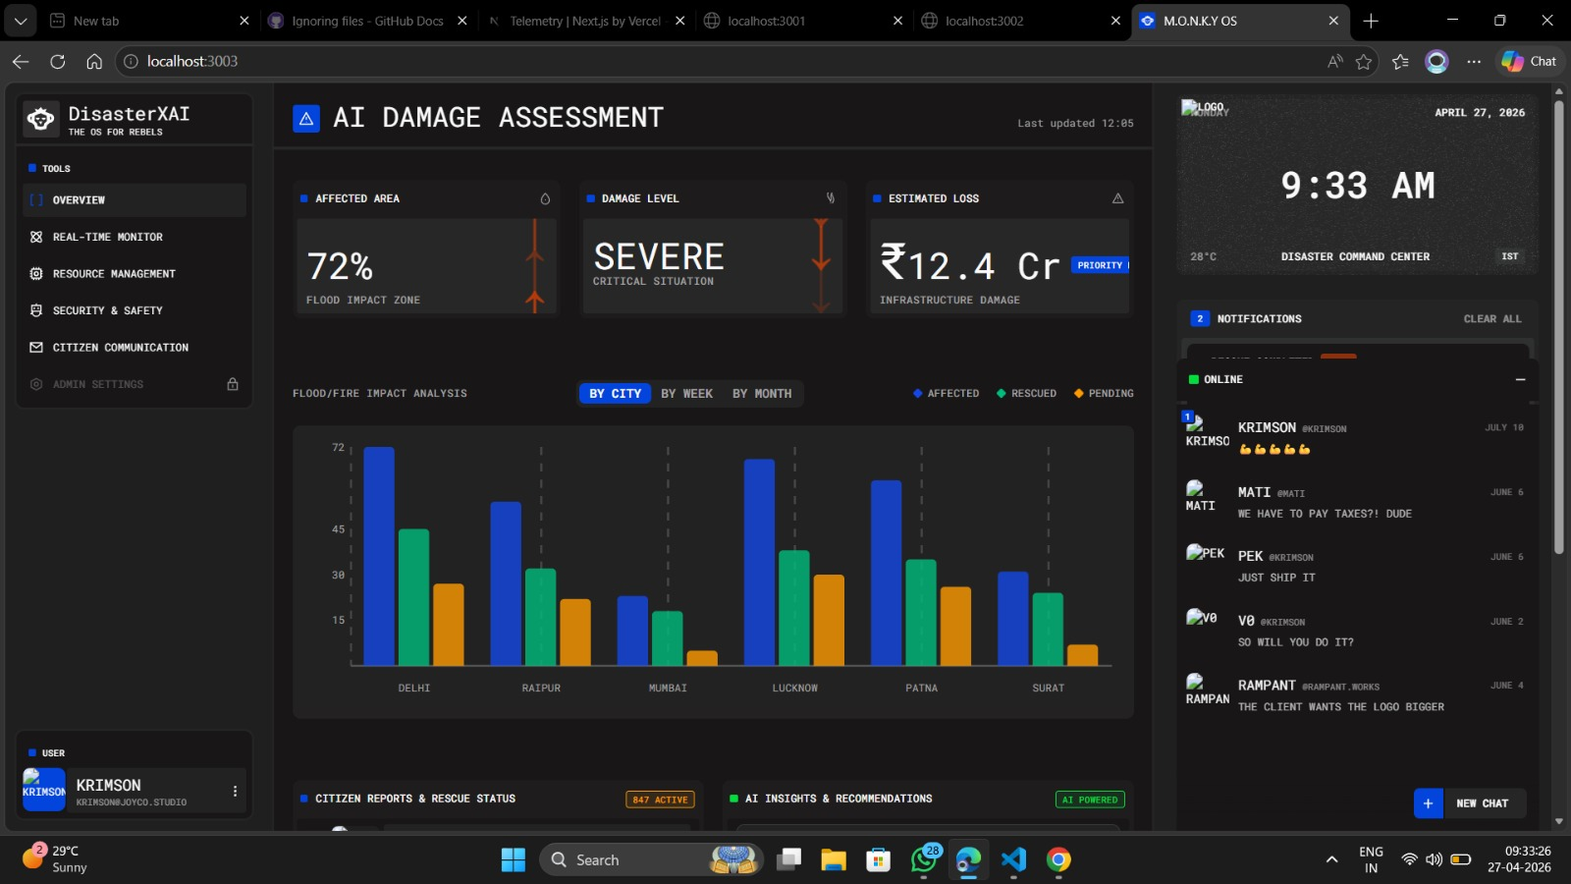
OVERVIEW
AI Damage Assessment
16 / 20
Overview Dashboard — Flood/Fire Impact Analysis by City
72% Affected Area • Damage Level: SEVERE • Estimated Loss: ₹12.4 Cr • 847 Active Citizen Reports

Slide 17
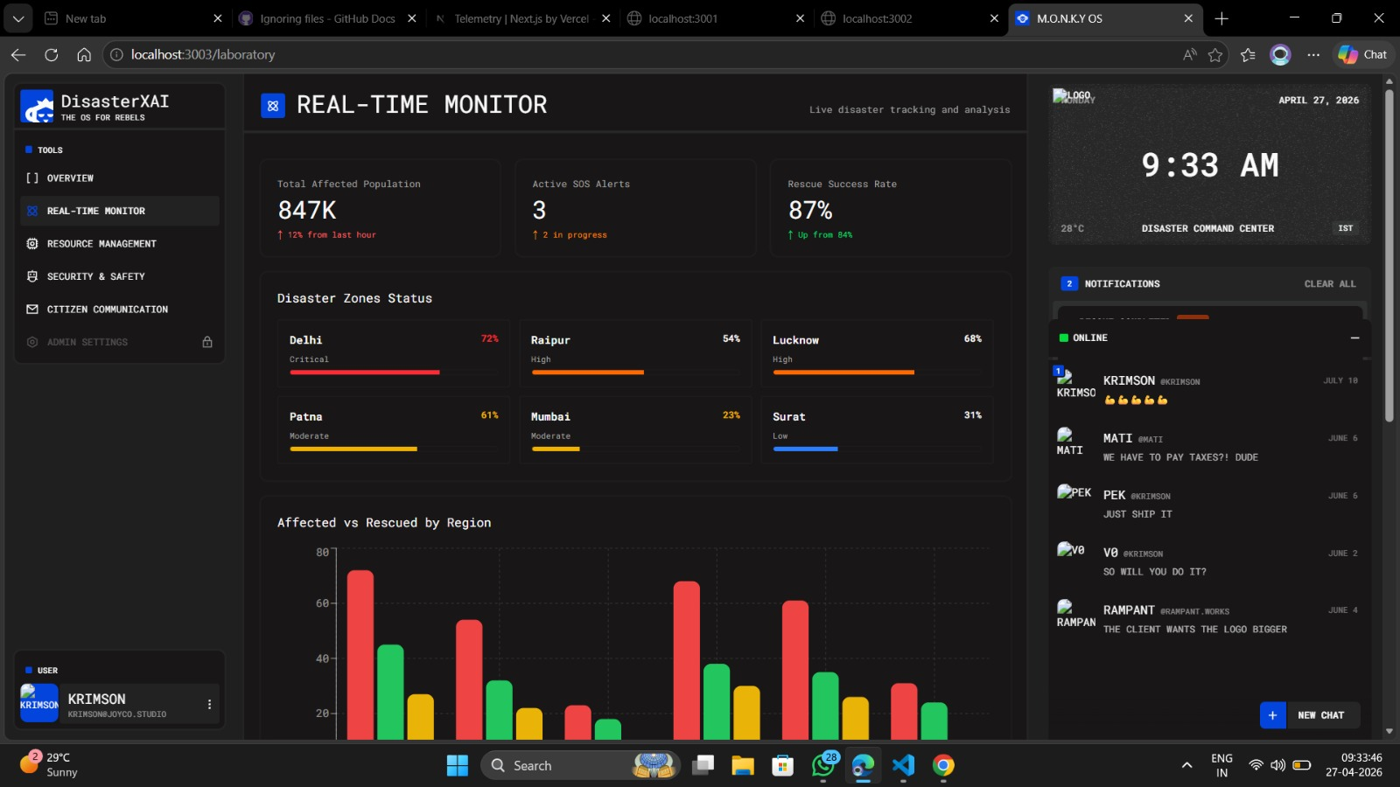
REAL-TIME
Real-Time Monitor
17 / 20
Live Disaster Tracking & Zone Status Across Cities
847K Total Affected • 3 Active SOS Alerts • 87% Rescue Success Rate • 6 Cities Tracked

Slide 18
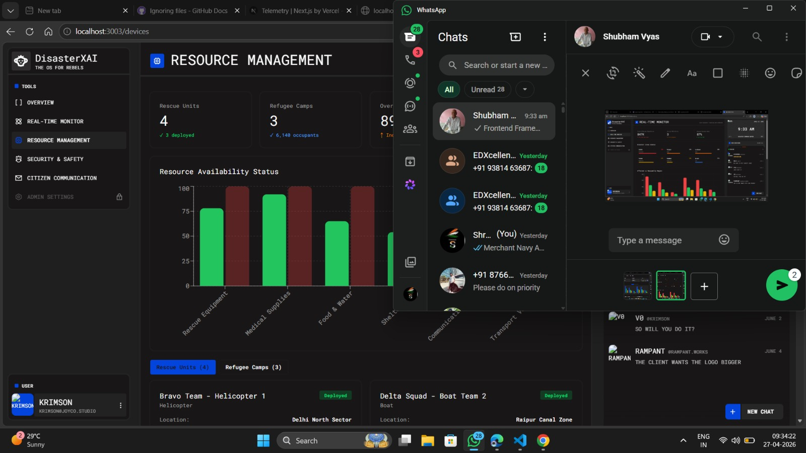
RESOURCES
Resource Management
18 / 20
Rescue Units, Refugee Camps & Availability Status
4 Rescue Units • 3 Refugee Camps (6,140 Occupants) • Multi-category Resource Availability Chart

Slide 19
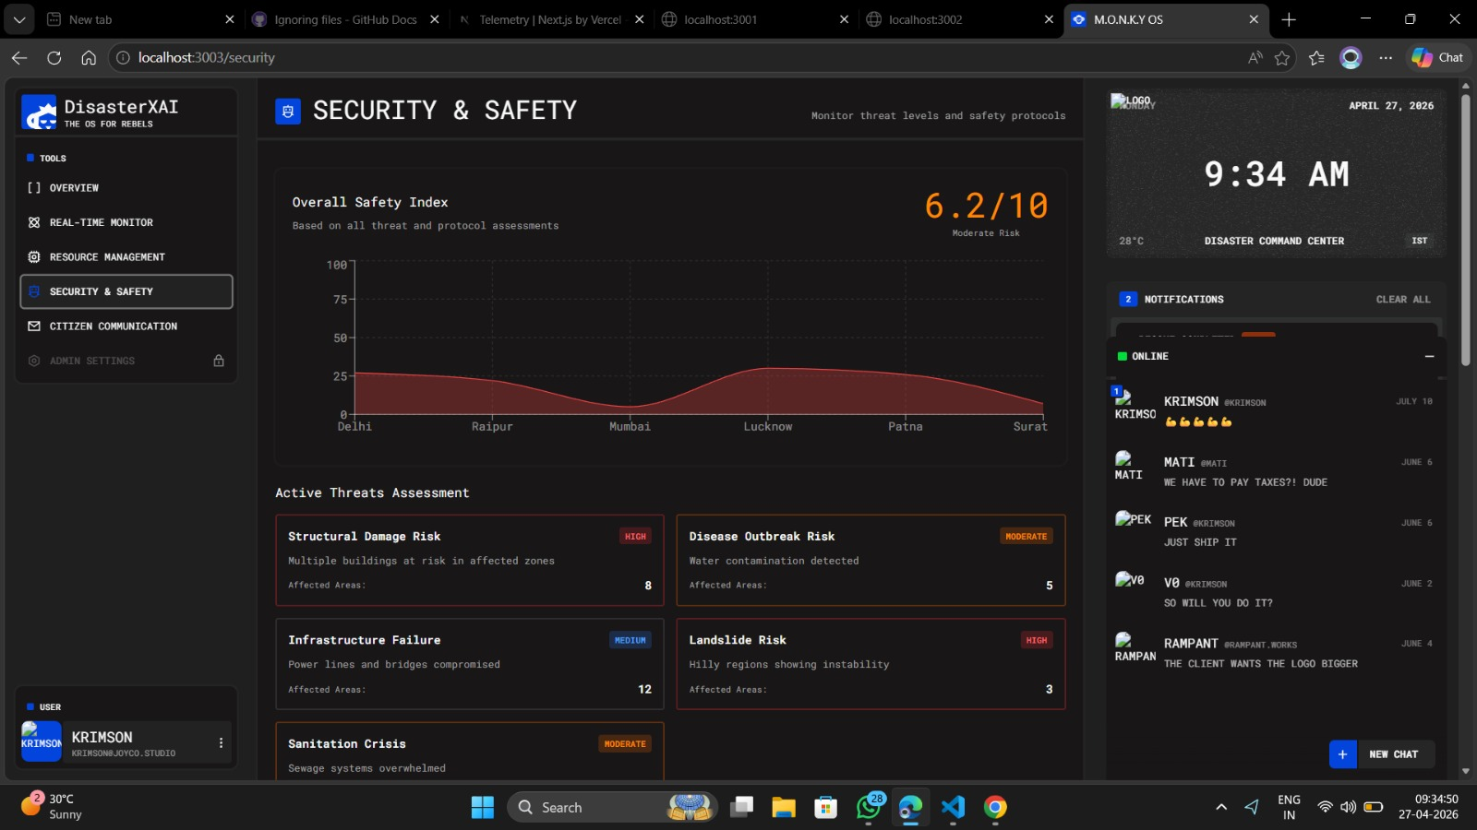
SECURITY
Security & Safety
19 / 20
Threat Level Monitoring & Safety Protocol Assessment
Overall Safety Index: 6.2/10 (Moderate Risk) • 5 Active Threat Types • Structural, Disease, Landslide Risks

Slide 20
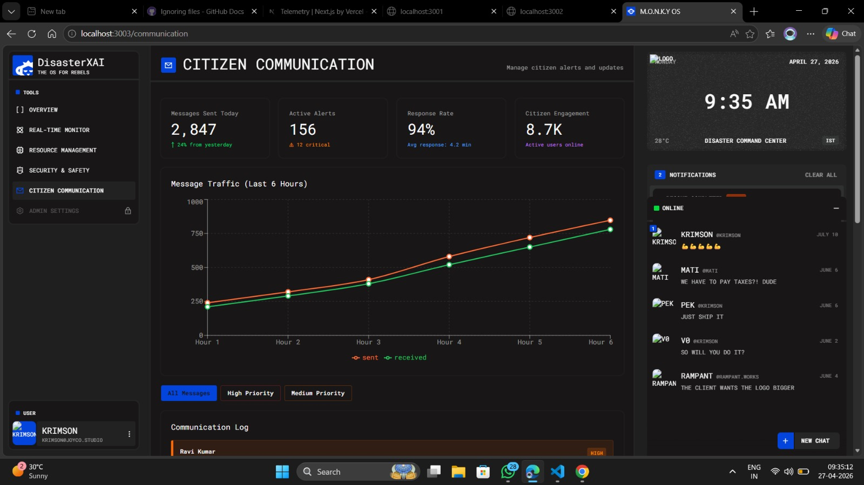
COMMUNICATION
Citizen Communication
20 / 20
Alert Broadcasting & Message Traffic Dashboard
2,847 Messages Sent Today • 156 Active Alerts (12 Critical) • 94% Response Rate • 8.7K Engaged Citizens

